Slide 1

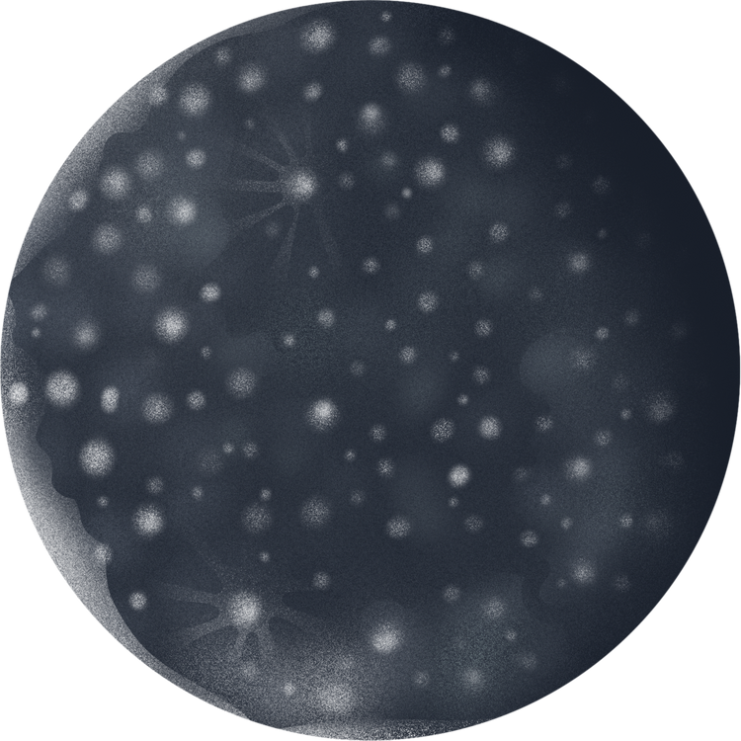

SUPERVISED LEARNING FOR FINDING PATTERN IN SENTINEL SATELLITE DATA
Authors:
M A Moontasir Abtahee, ID: 19301150
Rakesh Rakshit, ID:19101588
Istiak Ahmed Alin, ID:19201087
Maisha Jarin, ID: 20101125

Slide 2




INTRODUCTION
Brief Overview:
Significance of deep learning in satellite image categorization.
Utilization of EuroSAT dataset with 13 multi-spectral bands.

Slide 3


RESEARCH OBJECTIVES
Objectives:
Develop and assess deep learning models for EuroSAT image categorization.
Evaluate the performance of VGG16 and ResNet50 architectures.

Slide 4

Research Methods
METHODOLOGY OVERVIEW
DATA PREPROCESSING:
LABEL ENCODING:
MODEL CONSTRUCTION:
One-hot encoding for model compatibility.
CNN architectures: VGG16 and ResNet50.
Extract, standardize, and balance EuroSAT dataset.
DATA AUGMENTATION:
TRAINING PROCESS:
EVALUATION:
Early halting, model checkpointing, and learning rate reduction.
Assess models on test set using various metrics.
Keras ImageDataGenerator for increased model resilience.

Slide 5
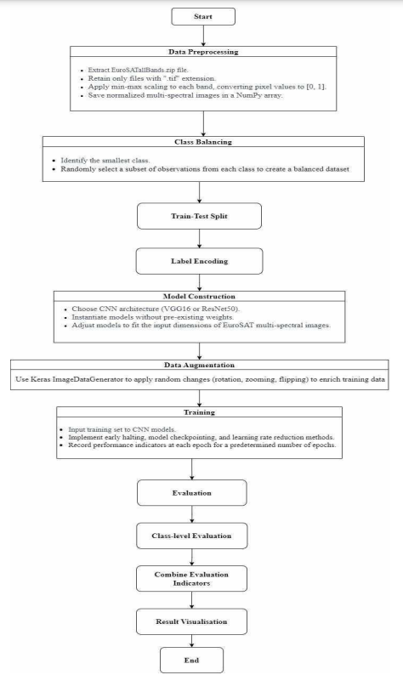

FLOWCHART OF THE METHODOLOGY.

Slide 6



DATA PREPROCESSING
(Specifics):
Extract EuroSATallBands.zip and filter ".tif" files.
Min-max scaling for standardization.
Class balancing for equal representation.
Stratified division into training and testing sets.
Data Preprocessing Visual: Before and after images of preprocessed data.

Slide 7


Model Architecture
CNN MODEL ARCHITECTURE
Details:
VGG16 and ResNet50 architectures.
Adjusted for EuroSAT multi-spectral image dimensions.
No pre-existing weights for better adaptation.

Slide 8
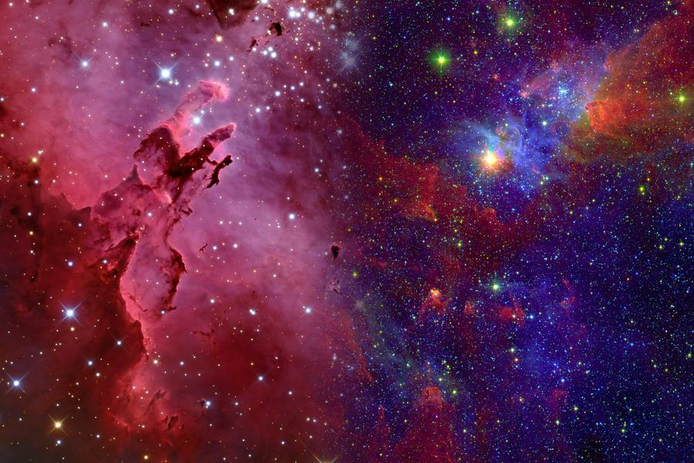


Data Augmentation
DATA AUGMENTATION FOR MODEL ROBUSTNESS
Techniques:
Rotation, zooming, flipping via Keras ImageDataGenerator.
Enhancement of data diversity and model resilience.

Slide 9

Training Process
SUPERVISED TRAINING PROCESS
COMPONENTS:
VISUAL:
Supervised training with early halting.
Model checkpointing for saving best-performing models.
Learning rate reduction for improved convergence.
Training curves showing loss and accuracy trends.

Slide 10
Evaluation Metrics
PERFORMANCE EVALUATION METRICS
METRICS:
VISUAL:
Categorical cross-entropy loss.
Classification accuracy.
Class-specific metrics (precision, recall, F1-score).
Confusion matrix highlighting true positives, negatives, false positives, and negatives.

Slide 11

Results Analysis
EMPIRICAL FINDINGS AND ANALYSIS
Model Performance:
Detailed analysis of VGG16 (M_MS_VGG16) and ResNet50 (M_MS_ResNet50).
Interpretation of loss, accuracy, and class-specific metrics.
Visual: Comparative analysis charts and graphs.

Slide 12
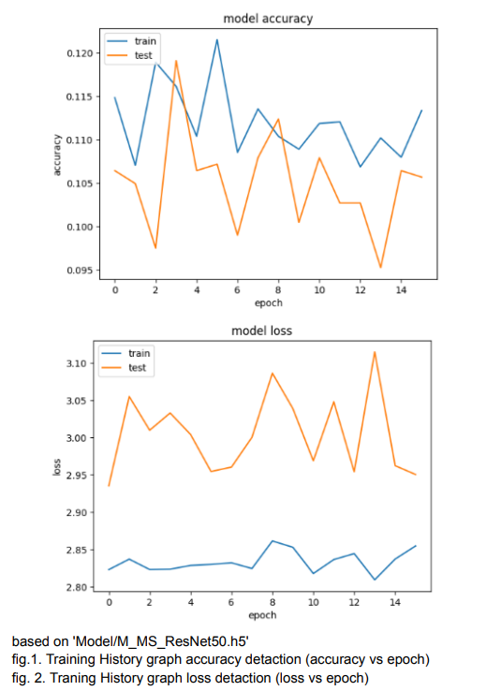
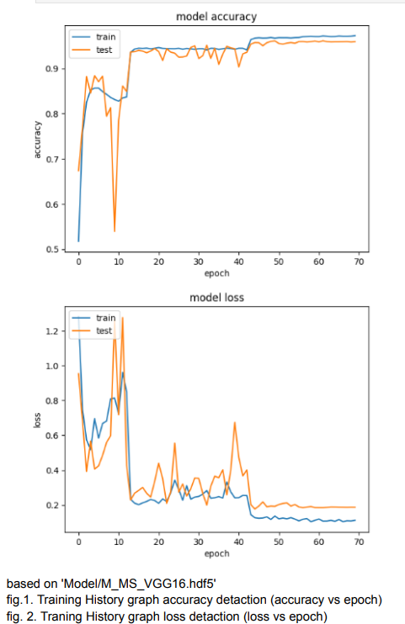

Slide 13

LIMITATIONS
Identified Challenges:
Challenges faced during model training and evaluation.
Limitations of the selected CNN architectures.
Suggestions: Recommendations for addressing limitations.

Slide 14
FUTURE WORK
Opportunities for Improvement:
Potential enhancements in model architecture.
Exploration of advanced deep learning techniques.
Collaboration: Encouragement for collaborative research in the field.

Slide 15
conlusion
CONCLUSION AND KEY TAKEAWAYS
Summary:
Recap of research objectives and methodology.
Key findings and contributions to the field.
Encouragement for further research in satellite image classification.

Slide 16
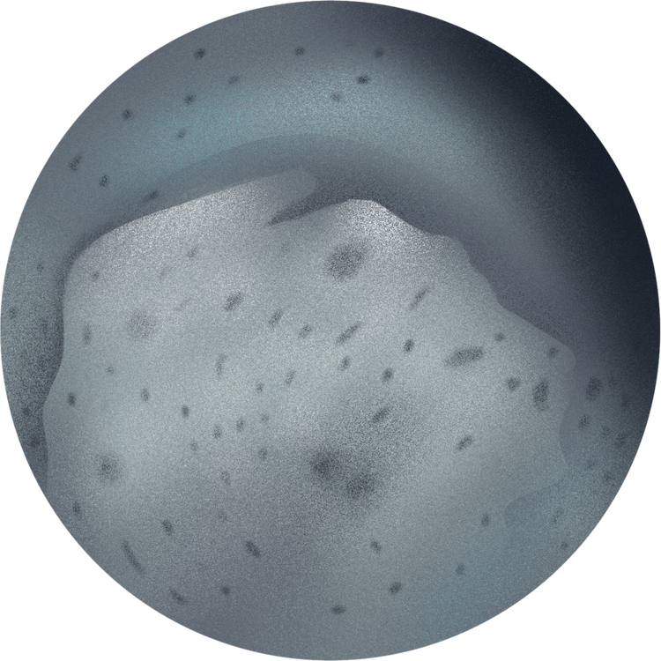



THANK YOU

